Slide 1

FitApp: Final Presentation
FitApp| Team 6 | CS 473/673 SW-ENG Fall 2015

Slide 2
Project Proposal (Rasha)
FitApp: A website that will input health and fitness data, and provide data analytics and wellness tips.
  Intended to sync data from multiple sources (pedometer, heart rate monitor, sleep monitor, nutrition tracking) and provide an overall picture of wellness.
Site Languages: Node.js, HTML/CSS, MongoDB

Slide 3
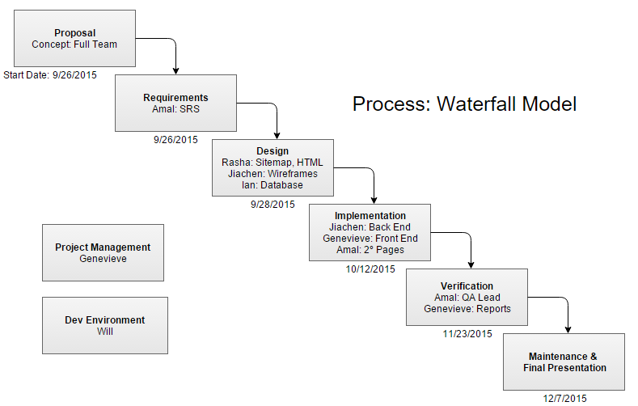
(Genevieve)

Slide 4
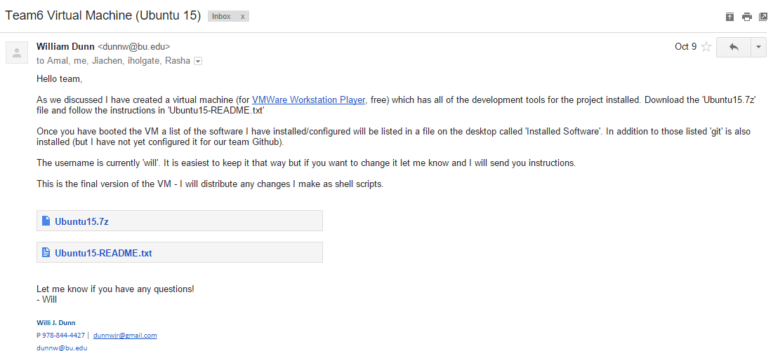
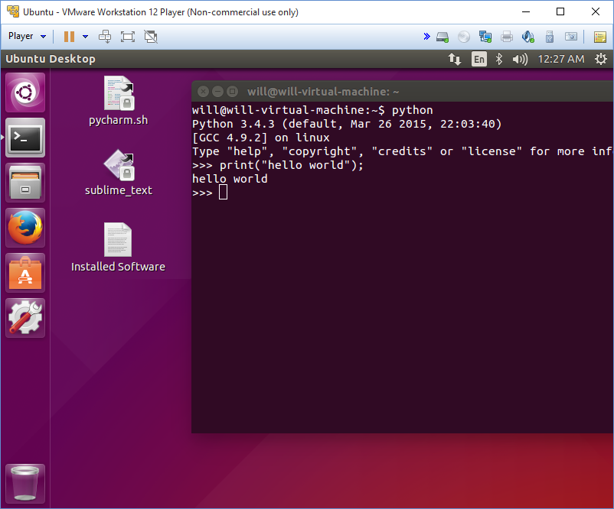
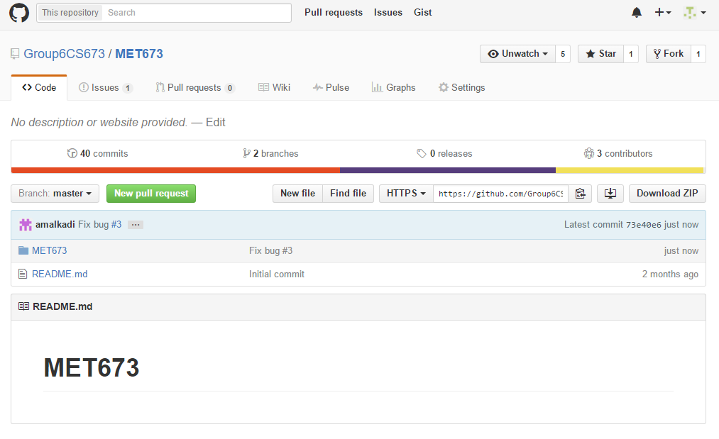
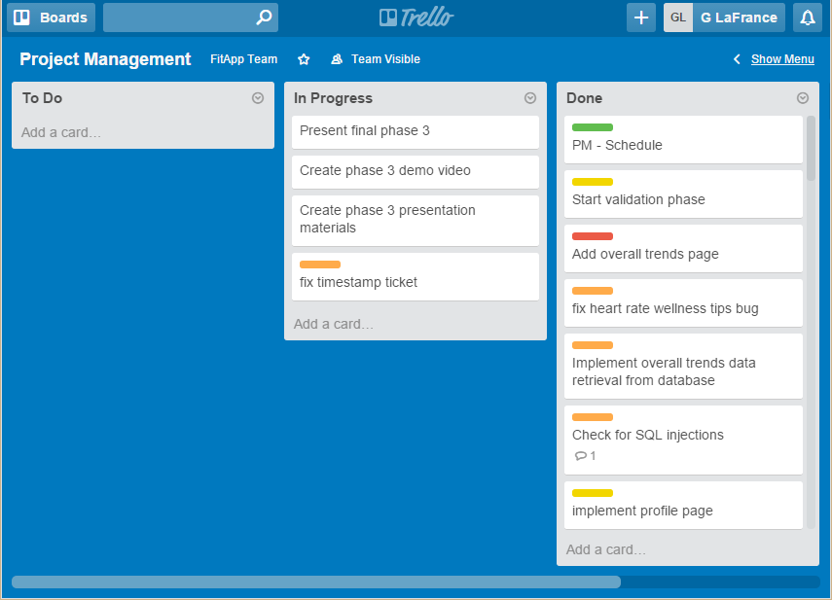
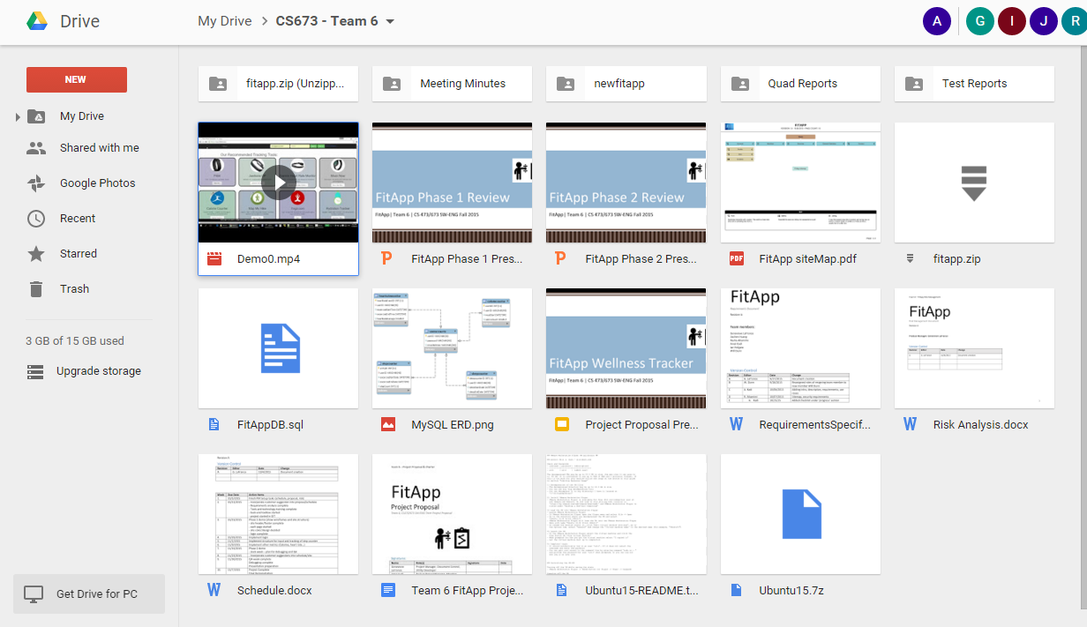
Tools (Ian)
GitHub
Google Drive
Trello
Email
Ubuntu VM

Slide 5
What Didn’t Work (Will)
Development Environment: We changed back end languages too frequently for the environment to keep up, and then had already installed/configured each of the tools on our personal machines.
Technology Choices: We were not familiar with back end technology, and spent time learning python and PHP before choosing node.js

Slide 6
What Worked (Jiachen)
Design Phase: We generated a lot of input to consider (wireframes, requirements, HTML mockups) and had great communication via in-person meetings and email groups.
Code Reviews: We centralized a lot of duplicated code, and caught a few bugs.
Skeleton: We created a back end skeleton for the site, then built on the front/back end to match the design and requirements documents.
Tools: GitHub and Google Drive were a good way to centralize file sharing and manage version control.

Slide 7
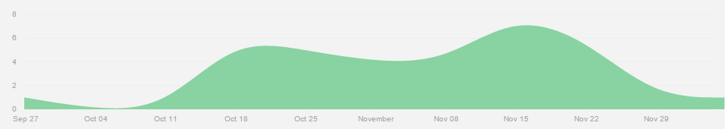
What We Learned (Genevieve)
Communication is better in person. We were more productive in the weeks after in-person meetings (observed from GitHub commit graphs and Google Drive upload dates).
Tools: Other groups mentioned tools during their demos. We would consider using some of these tools (like Slack, or pre-recorded demos) in future projects.
Clear Requirements: We spent a lot of time developing and accepting the requirements, which made implementation and validation simple to plan/measure.
Development Environment: A common VM was a good idea, but wasn’t as practical as we hoped for this project due to switching languages.

Slide 8
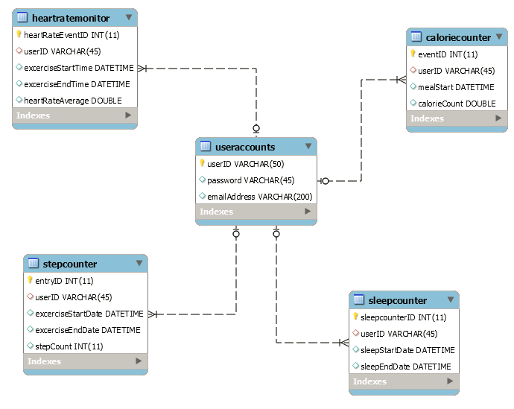
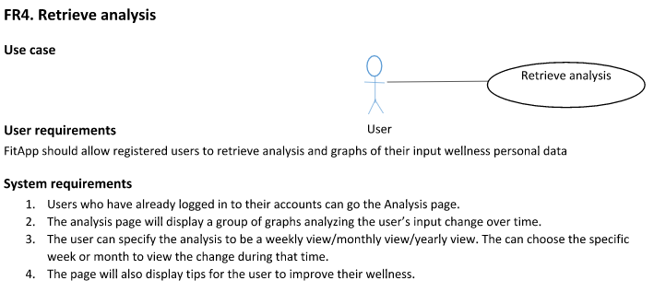
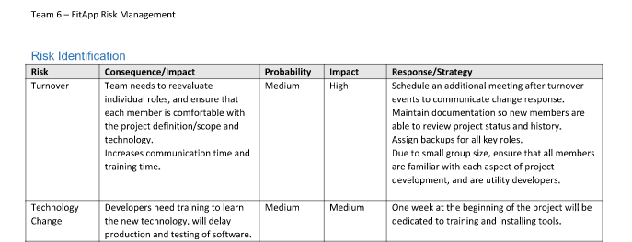
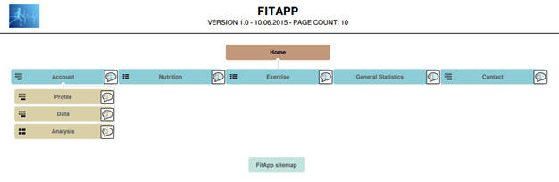
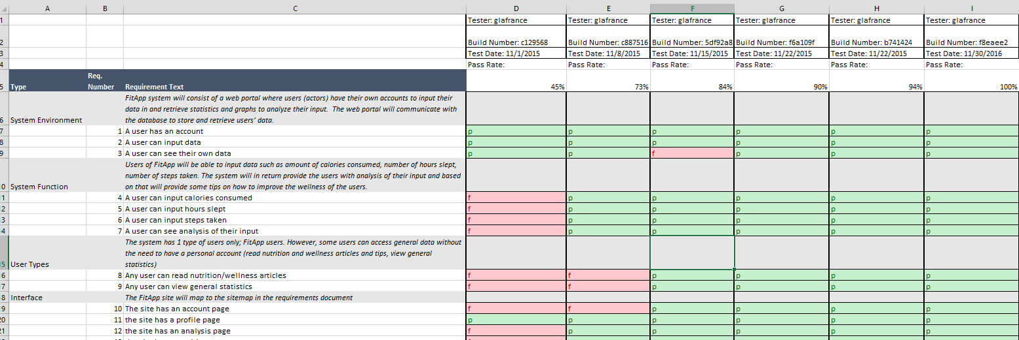
Demo (Docs)
Proposal
Site Map
Requirements
Risk Analysis

Slide 9
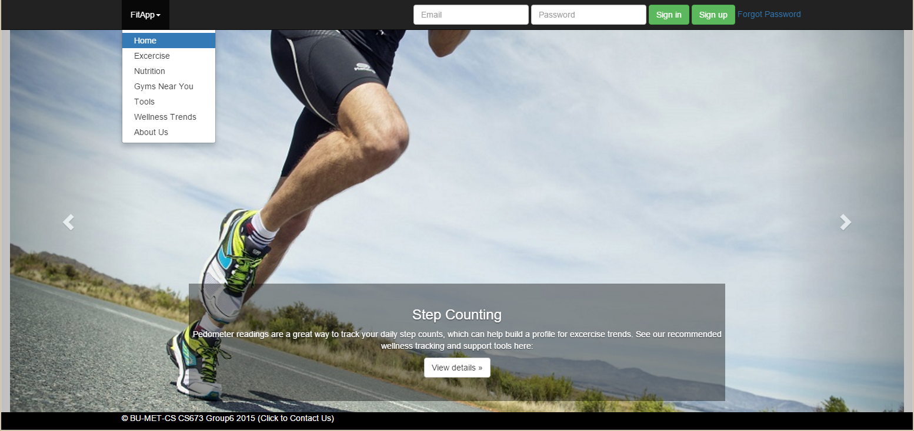
Demo (Site) (Amal):
https://drive.google.com/open?id=0B4Q-ZhbOUFWzNGhEcTFNU1hDdjQ

Slide 10
Project Links
GitHub: https://github.com/Group6CS673/MET673
Trello: https://trello.com/b/jUbA0L3X/project-management
Google Drive: https://drive.google.com/drive/folders/0B4Q-ZhbOUFWzNUdPUXV0OVk1WGc
  Virtual machine image, quad reports, project proposal, presentations, requirements, test reports, site design documents, meeting minutes, demo, risk analysis, schedule.

